Slide 1
DATA 228 Term Project
Twitter Sentimental Analysis for Stock Recommendation
Defense Presentation
PRESENTED BY
HARSHITHA MOHANRAJ RADHIKA
JANANI RAVI KUMAR
ROHAN NAGA VENKATA MAYUKH UNGARALA

Slide 2
IMPLEMENTATION
Spark API is available in multiple programming models and languages such as Scala, Java, Python, and R. We are using Python, programming language in our Stock recommendation system.
Spark has three different data structures available through its APIs: RDD, Dataframe, and Datasets. The corresponding machine learning library is SparkML. We are using accuracy to validate the efficiency of our model.
Linear Regression Machine learning algorithm is used to predict the stock prices of each company listed in our input csv file
stock investment recommendations is based on Machine Learning predictions from last 3 years values of any market symbol and also based on Twitter sentiment analysis from retrieved tweets
actual_date = dt.date.today()
past_date = actual_date - dt.timedelta(days=365 * 3)

Slide 3
IMPLEMENTATION (Cont.)
The dataset is split using the method train_test_split from sklearn model selection that splits arrays or matrices into random train and test subsets
train, test = sparkDf.randomSplit([0.7, 0.3], seed = 2018)
We input the symbol of a company to retrieve the stock data corresponding to that particular symbol
The financial data of the particular company is downloaded from yfinance using the symbol, start date and end date. The data collected is stored in a dataframe with columns 'Open', 'High', 'Low', 'Close', and 'Volume'.
To access Twitter data using tweepy API, we created a twitter developer platform to get the API_key, Access token, API_secret key and Access token secret key. Number of tweets to be fetched is given implicitly to the attribute num_of_tweets
Based on the polarity stock recommendation is suggested to the investor on whether to invest in a particular company’s stock. If the polarity is greater than 0 it is considered to be positive and is recommended to the investor as a good idea to invest. Otherwise it is considered as a negative tweet.

Slide 4
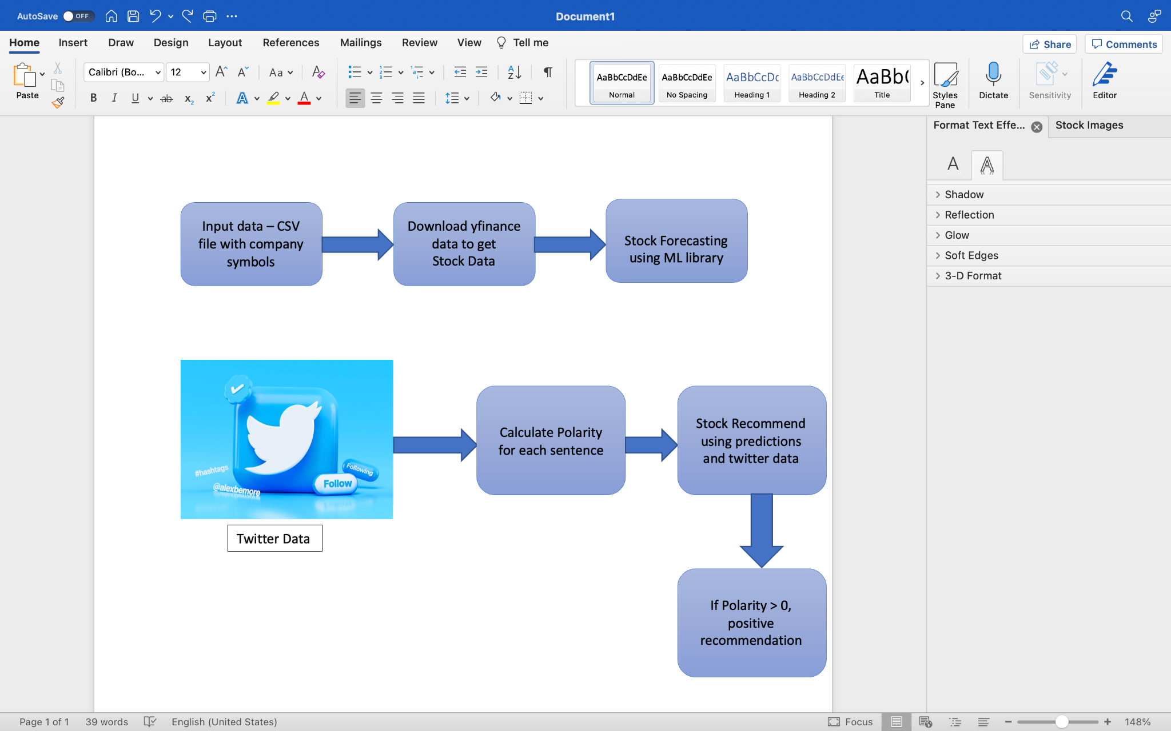
IMPLEMENTATION (Cont.)
Flowchart for Stock recommendation using Twitter Sentiments

Slide 5
DATA ANALYSIS AND DISCUSSION
OUTPUT GENERATION
Using Linear Regression the prediction for stocks is done and once the stock prediction is completed, we are using the tweets that are retrieved from twitter using the twitter development account that matches the symbol of the companies.
The results from the prediction are used to make the recommendation for the stocks. We have checked whether the forecasted predicted value and global polarity.
If the global polarity and predicted closed value both are high, then the stock is considered to be positive and it is suggested as a great idea.
If any of the one either global polarity or predicted closed value is low, then the stock is considered to be negative and it is suggested as a bad idea.

Slide 6
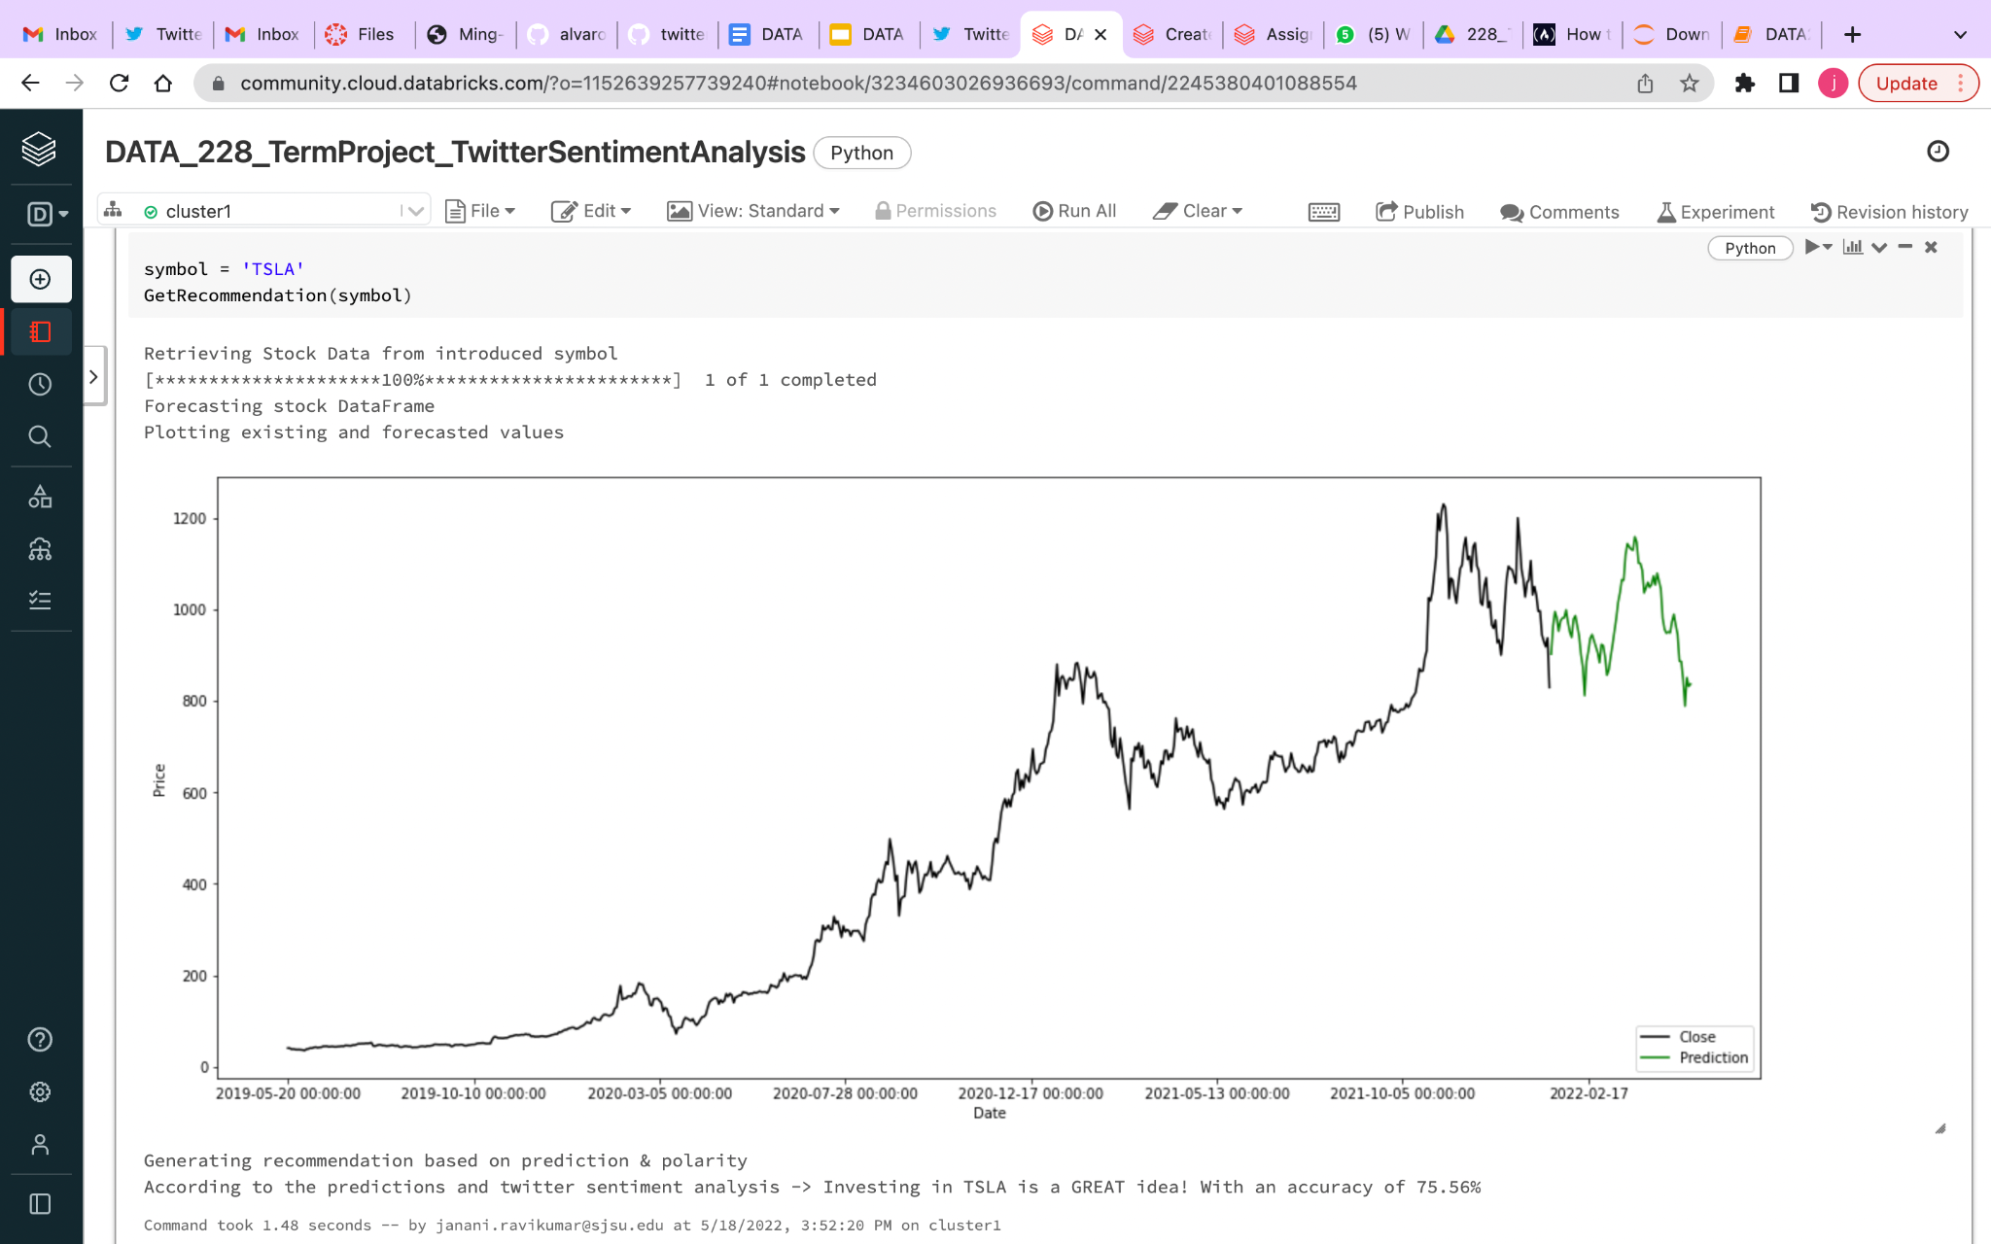
DATA ANALYSIS AND DISCUSSION (Cont.)
OUTPUT GENERATION
def recommending(df, forecast_out, global_polarity, accuracy):
if df.iloc[-forecast_out-1]['Close'] < df.iloc[-1]['Prediction']:
if global_polarity > 0:
print("According to the predictions and twitter sentiment analysis -> Investing in %s is a GREAT idea! With an accuracy of %.2f%%" % (str(symbol), accuracy))
elif global_polarity < 0:
print("According to the predictions and twitter sentiment analysis -> Investing in %s is a BAD idea! With an accuracy of %.2f%%" % (str(symbol), accuracy))
else:
print("According to the predictions and twitter sentiment analysis -> Investing in %s is a BAD idea! With an accuracy of %.2f%%" % (str(symbol), accuracy))

Slide 7
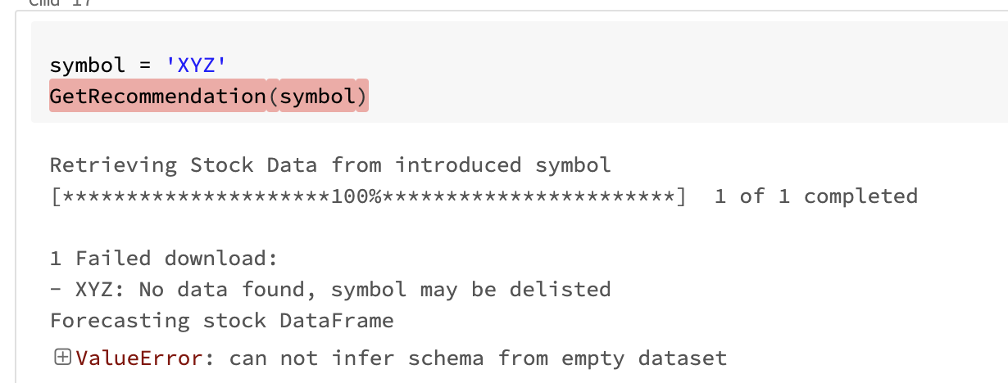
DATA ANALYSIS AND DISCUSSION (Cont.)
OUTPUT ANALYSIS
The dataframe was created to store the companies list csv file.The function check_stock_symbol will check if the company we request is present in the csv file .If the company is not found in the csv list it will throw an error

Slide 8
DATA ANALYSIS AND DISCUSSION (Cont.)
OUTPUT ANALYSIS(cont.)
The stock_forecasting function is used to start modelling the data frame using Vector Assembler and used linear regression algorithm for predicting the values.Using Linear Regression algorithm the data is split into training and testing and the accuracy is found.
We have used linear regression because it gives us most appropriate accuracy when compared with the other.The ‘close’ is represented in black lines and ‘prediction’ values are represented as green in the plot diagram.

Slide 9
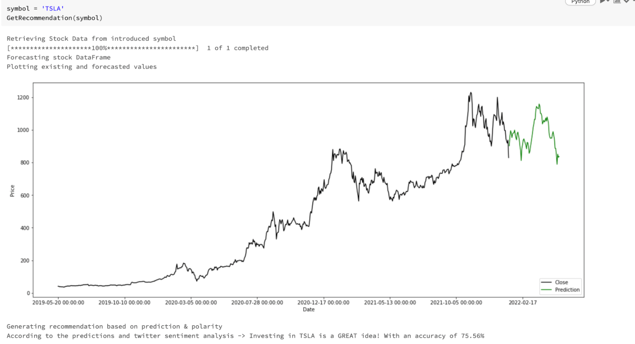
DATA ANALYSIS AND DISCUSSION (Cont.)
OUTPUT ANALYSIS(cont.)
The accuracy is displayed as (75.56%) and the recommendation is shown as ‘GREAT idea’ for ‘TSLA’

Slide 10
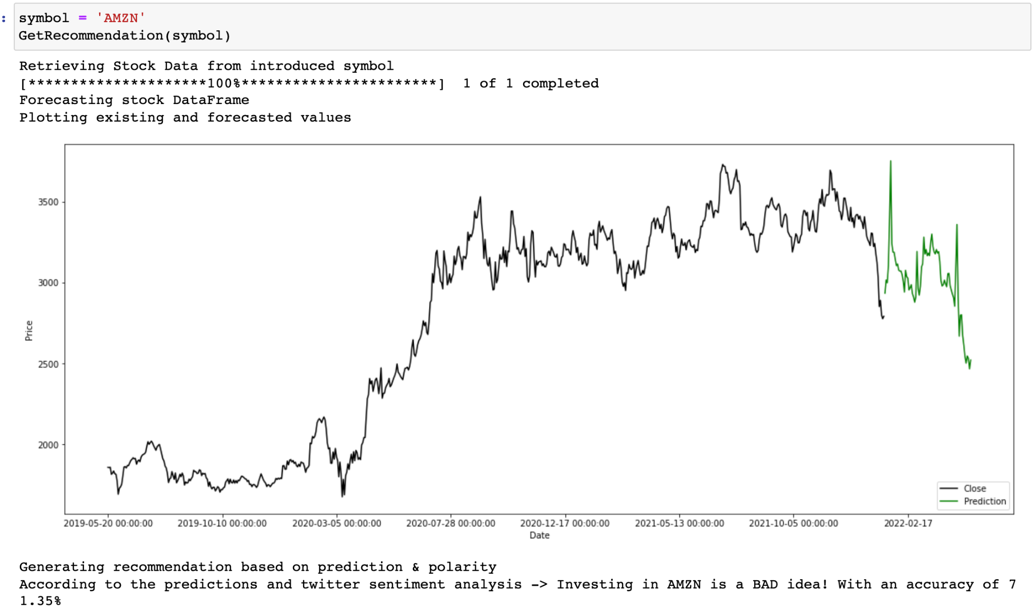
DATA ANALYSIS AND DISCUSSION (Cont.)
OUTPUT ANALYSIS(cont.)
The accuracy is displayed as (71.35%) and the recommendation is showed as ‘BAD idea’ and for ‘AMZN’

Slide 11
DATA ANALYSIS AND DISCUSSION (Cont.)
OUTPUT ANALYSIS(cont.)
We followed the same steps by calling the GetRecommendation function and found the accuracy and prediction whether its bad or good for 5 other stocks like ‘TSLA’,’AMD’,’AAPL’,’AMZN’,’MSFT’.Accuracy for each company varies by 1% more or less when the data is trained and tested again.
STOCKS | ACCURACY
AMZN | 71.75%
TSLA | 74.96%
AAPL | 87.40%
AMD | 61.30%
MSFT | 84.30%

Slide 12
DATA ANALYSIS AND DISCUSSION (Cont.)
OUTPUT ANALYSIS(cont.)
A global polarity variable is created and set to 0.The global polarity value is checked accordingly with the textblob and if the prediction value is comparatively same to the last non predicted value.
If the value of global polarity is less than zero the result will be displayed as “bad idea” which means we should not invest in the company.
If the global polarity value is greater than 1 or positive then the result will be displayed as “good idea” which means we should invest in the stocks of that company.

Slide 13
DATA ANALYSIS AND DISCUSSION (Cont.)
OUTPUT ANALYSIS(cont.)
The recommendations are made as ‘bad idea’,’bad idea’,’good idea’,’good idea’,’bad idea’ for ‘AAPL’,’AMZN’,’TSLA’,’AMD’,’MSFT’.
STOCKS | RECOMMENDATION
AAPL | BAD IDEA
AMZN | BAD IDEA
TSLA | GOOD IDEA
AMD | GOOD IDEA
MSFT | BAD IDEA

Slide 14
DATA ANALYSIS AND DISCUSSION (Cont.)
COMPARE OUTPUT AGAINST HYPOTHESIS
In chapter 4, we proposed about Hypothesis for the Twitter Sentimental Analysis for Stock Recommendation.
The steps which are used are as follows:
-> Initially we will be checking the symbol of the stock from the company list, then we will be doing the stock_forecasting in which we will be training and testing the data.
-> Secondly, we proposed that our project will demonstrate retrieving_tweets by polarity. It is measured by range from 1 to -1.Values closer to 1 indicate more positivity, while values closer to -1 indicate more negativity.

Slide 15
(Cont.)
COMPARE OUTPUT AGAINST HYPOTHESIS
->Finally, the stock recommendation is done with the help of global polarity. If it is greater than zero it is marked as “Great Idea” and less than zero is marked as “Bad Idea”.
So the output which we got it is expected as the same hypothesis as predicted.

Slide 16
DATA ANALYSIS AND DISCUSSION (Cont.)
ABNORMAL CASE EXPLANATION
The abnormal cases that we encountered were the stocks which are not that highly successful and not much tweeted such as AutoWeb, Entera Bio Ltd. these are not much highlighted.
But the highly tweeted companies like Tesla, Amazon,etc. So sometimes this leads us to difficulty in predicting the stocks because when we are discussing the stocks that means it must be able to predict all the stocks which are present.
This leads to the discussion below of what we feel needs to be explicitly emphasized when talking about stock prediction.

Slide 17
DATA ANALYSIS AND DISCUSSION (Cont.)
DISCUSSION
We feel that Stock Market Predictions is a common and well-known problem of interest.
So we basically retrieved the data from the famous American social networking site that is Twitter with the help of a “Twitter Developer Account” which we needed to request for the access to the developer account.
Once they approve it we can access the tweets, now we will check the stock company symbol whether it is in our company list or if not present it throws an error.
Once that is done then we will fetch the stock data from the yahoo finance we need to import all the required packages for this after fetching it will convert from dataframe to the desired columns.

Slide 18
(Cont.)
DISCUSSION
Now we will test 70% of data and 30% data we will be training it using the machine learning algorithm that is the Linear Regression which is used for prediction.
Once the prediction part is done with the help of polarity we will calculate the stocks and we will display the output whether it is good stock or bad stock.
Finally this project will help the customers who are new into the stock investments and also to the stock prediction experts who can verify with this such that the stocks can be invested very wisely.

Slide 19
CONCLUSIONS AND RECOMMENDATIONS
SUMMARY AND CONCLUSIONS
Machine Learning and pyspark have been used for better stock market analysis. The stock market is often uncertain. With this, we can help the investors from facing significant financial losses.
We have imported sklearn preprocessing module that has preprocessed the input data and removed the null values which gave us better accuracy, all more than 60 percent.
We have retrieved data from the last 500 tweets so when the data retrieved is more the accuracy increased.Apart from the linear regression methods, many methods can be implemented in finding better results.
We came to know that better results can be achieved by using the Neural networks.In the Neural networks we can increase the number of nodes to achieve better accuracy.
We also found that the Feed-Forward neural network will give a better accuracy prediction for the opening price of the stock.

Slide 20
CONCLUSIONS AND RECOMMENDATIONS
RECOMMENDATIONS FOR FUTURE STUDIES
As a future work our team would recommend to extract more historical tweets by purchasing a premium twitter developer subscription.We would really wish to purchase a premium twitter developer subscription that would have helped us to use all-time historical prices together with tweet attributes which would have given us higher accuracy.
When we get the premium developer subscription we can retrieve an enormous amount of training data that is 10 times as much as we have used now , which would make a huge difference.
We also found that it is interesting to add ARIMA which is a model that uses time series data to understand the dataset and predict stock prices and can also handle the linear part of the data set and use the neural network to handle the non-linear part.

Slide 21


